Slide 1
Blogbase final Demo report Aayushi gupta, Iris Wang

Slide 2
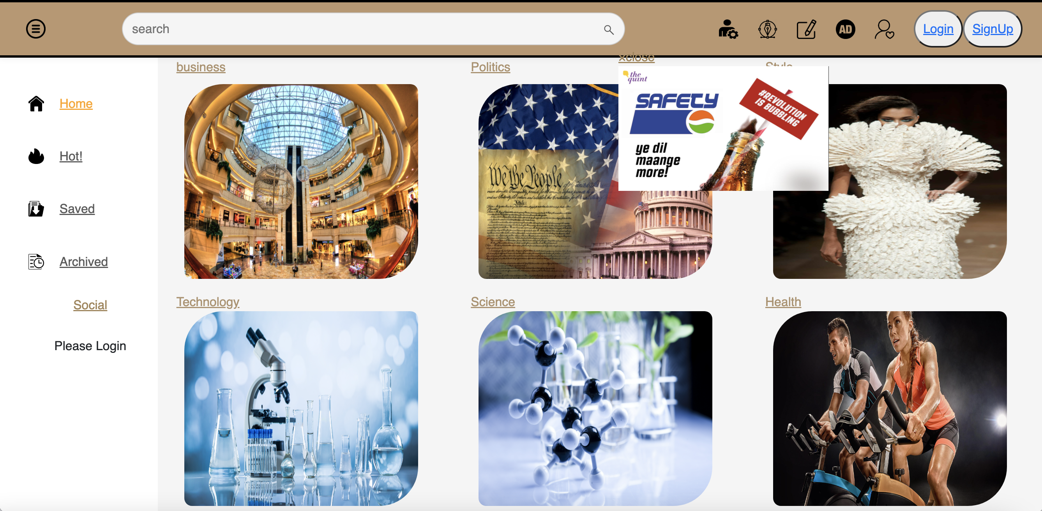
1
REGISTER WITH ROLE SELECTION
2
LAYOUT
3
CATEGORY
4
COMMENTS
CONTENTS
5
FUZZY SEARCH
6
FLOAT WINDOW
7
MODIFTY CK EDITOR
8
OTHER IMPROVES

Slide 3
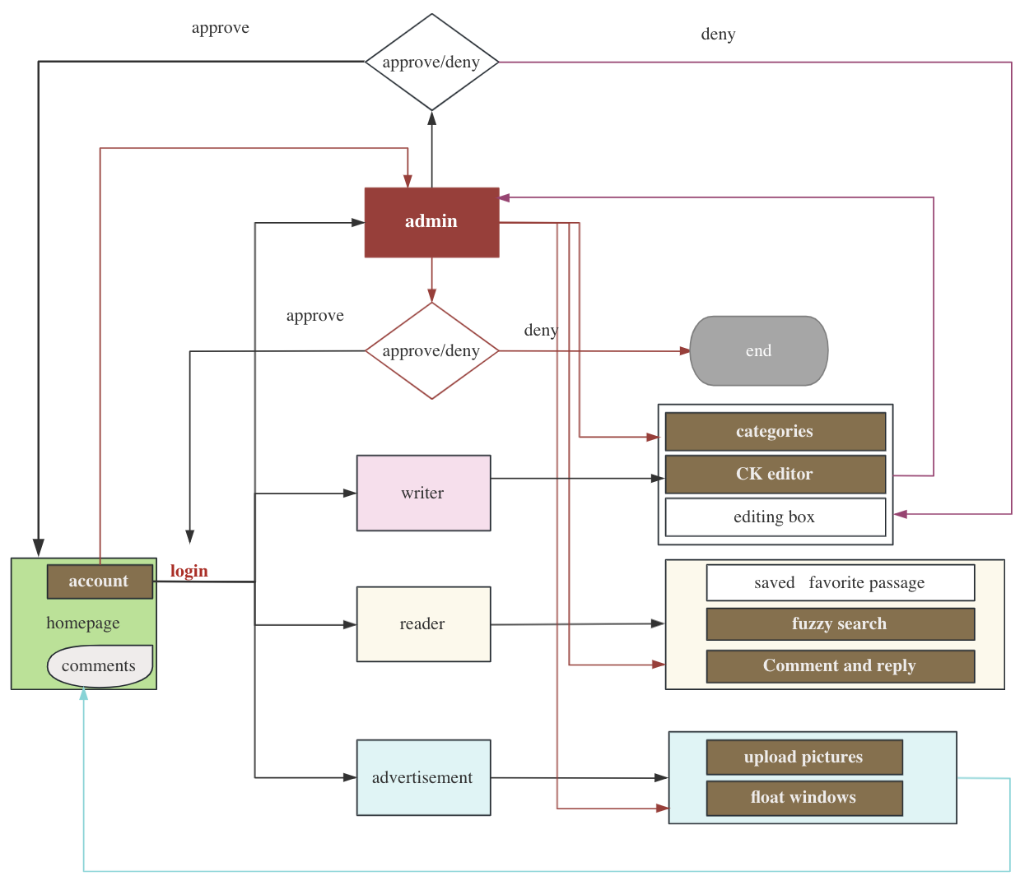
workflow

Slide 4
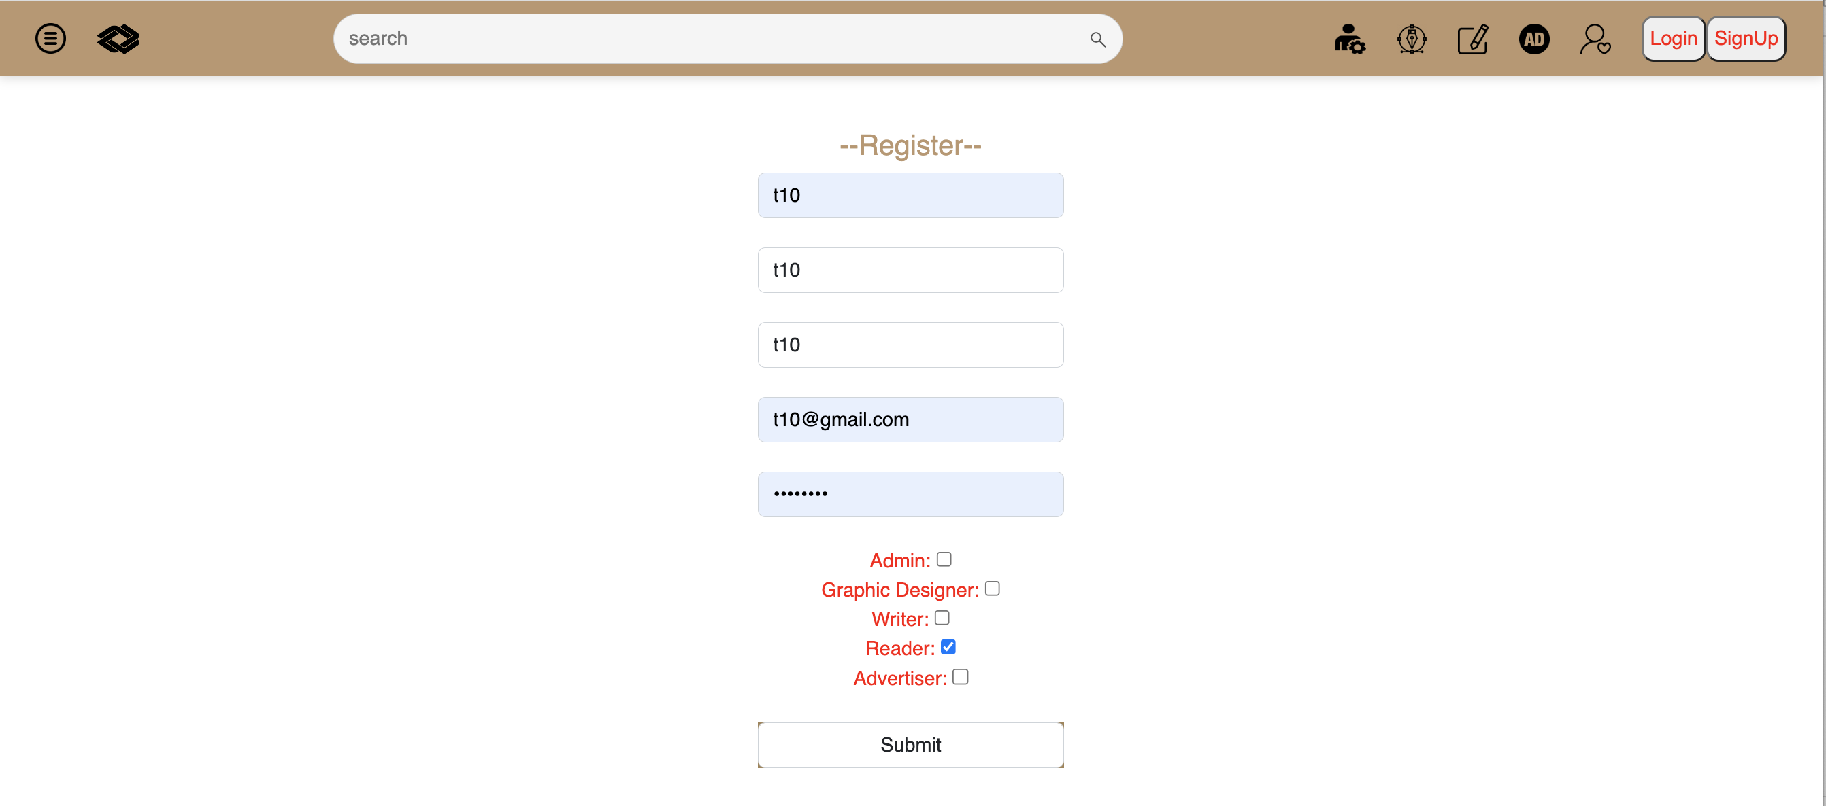
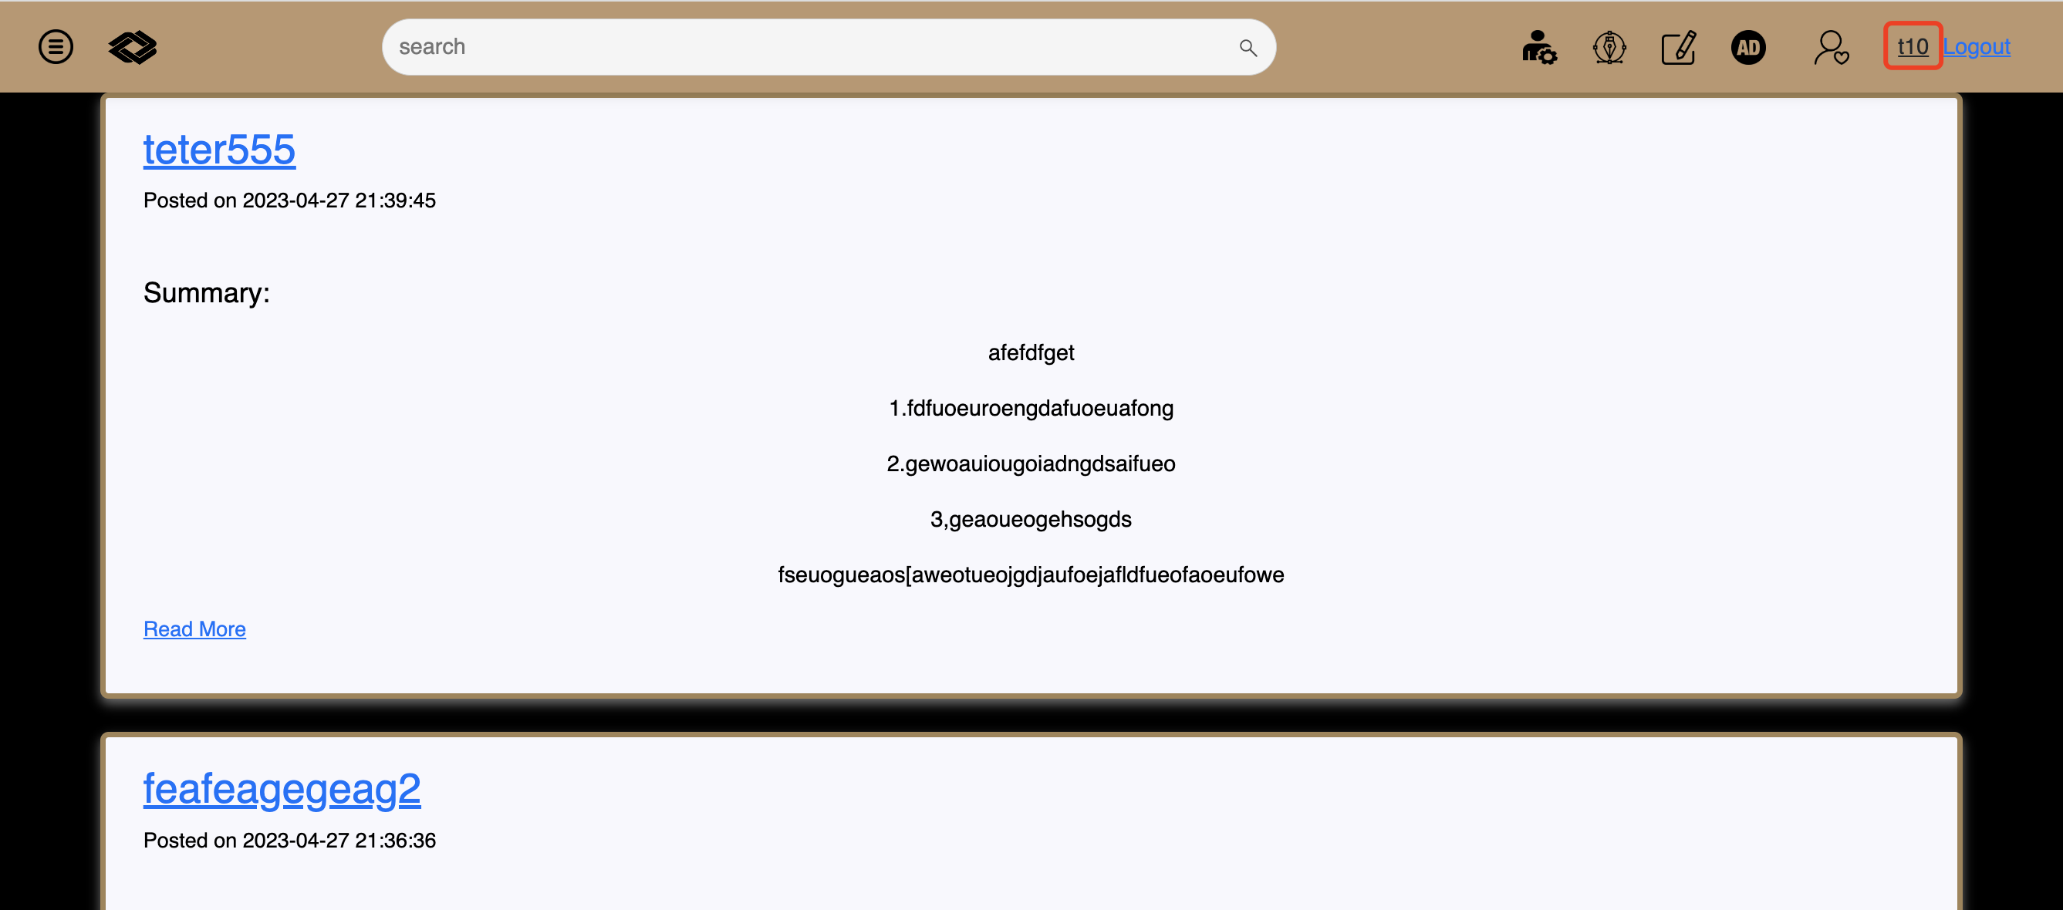
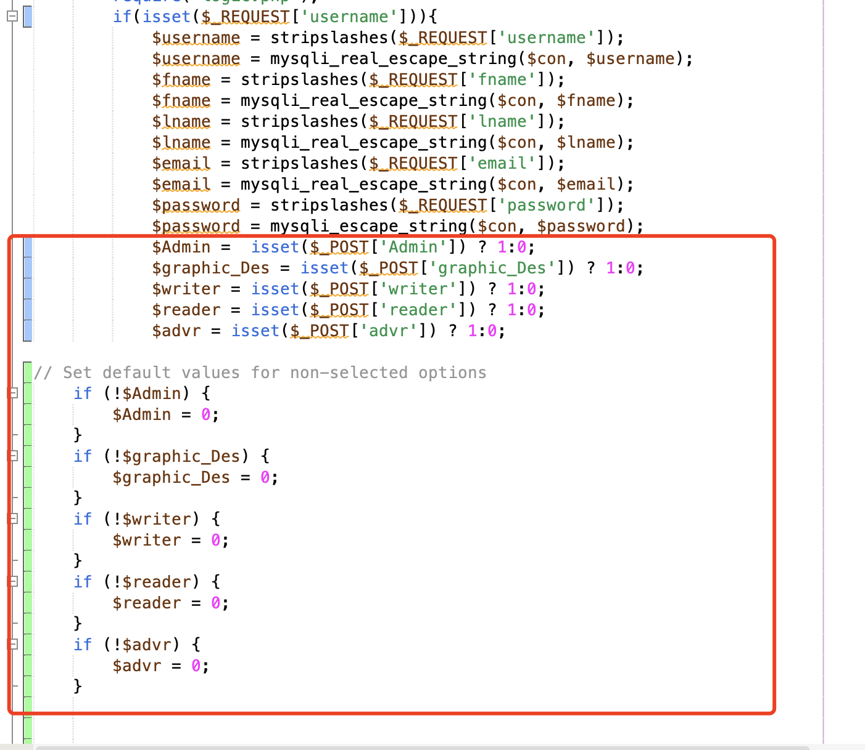
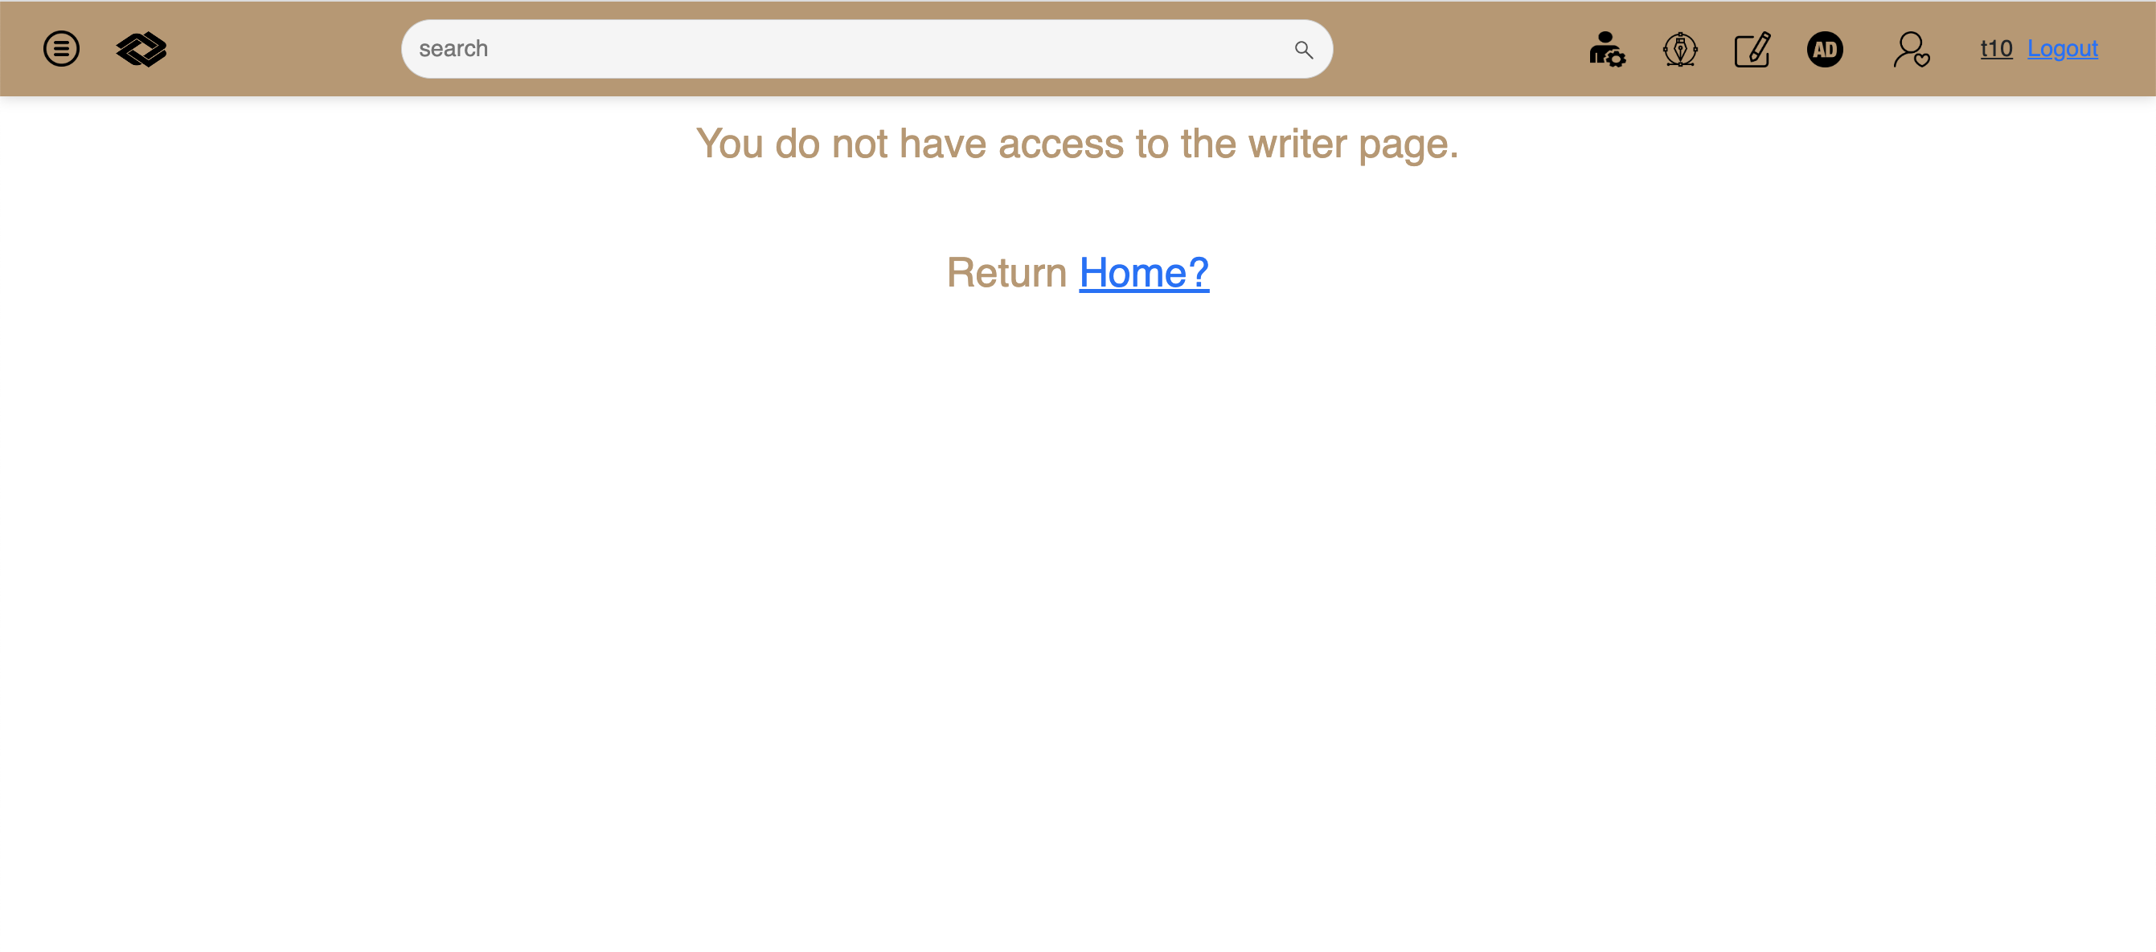

REGISTER WITH ROLE SELECTION
Add logic to control role selection in registration
Realize visiting authentication based on roles

Slide 5
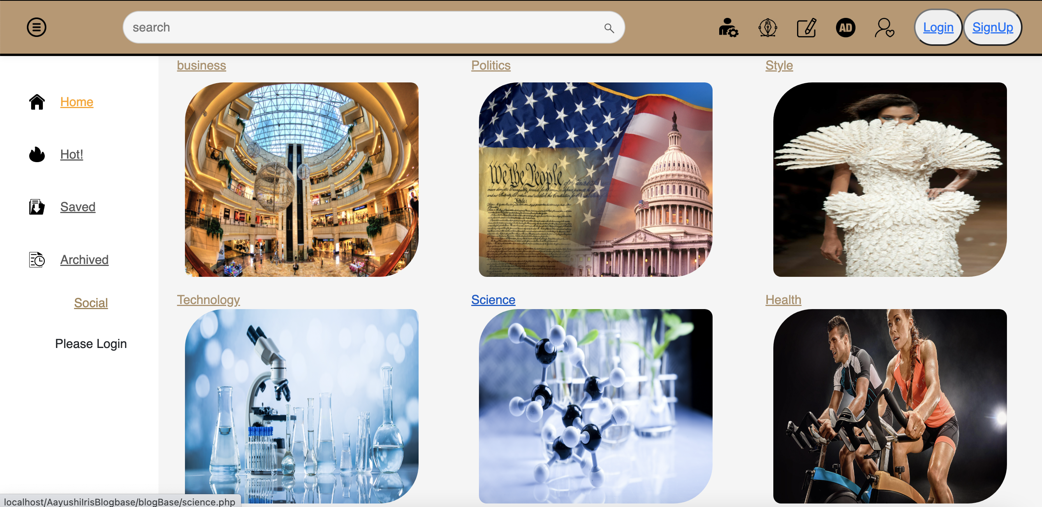
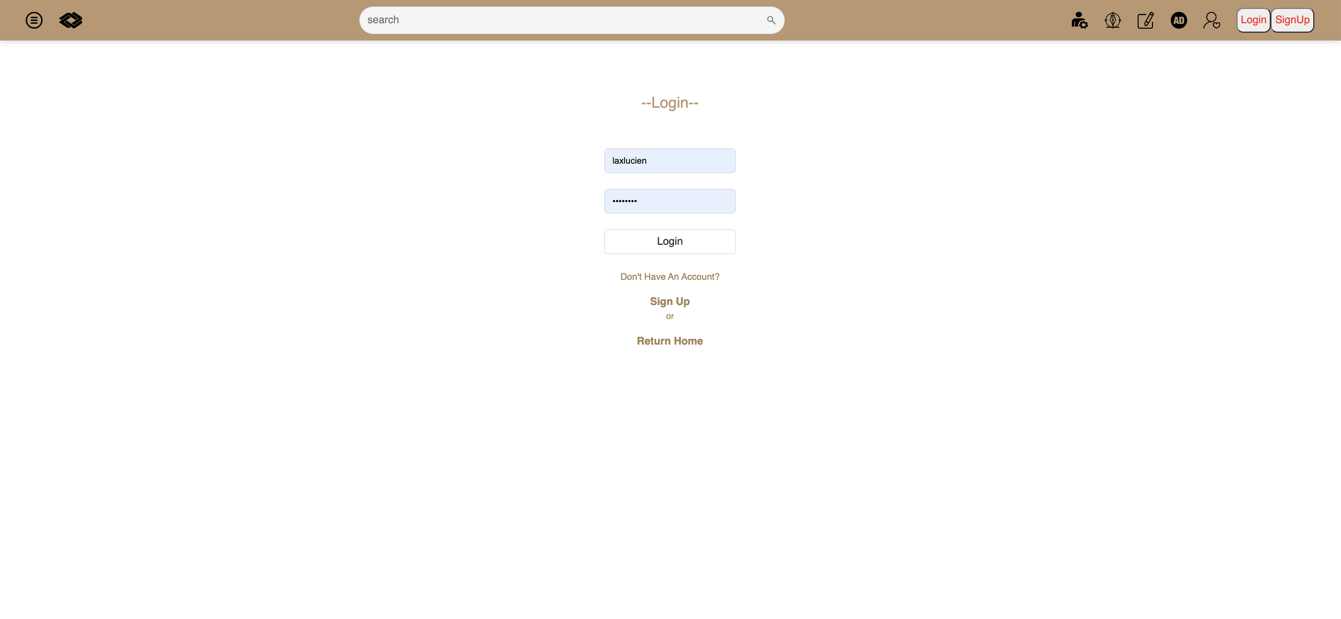
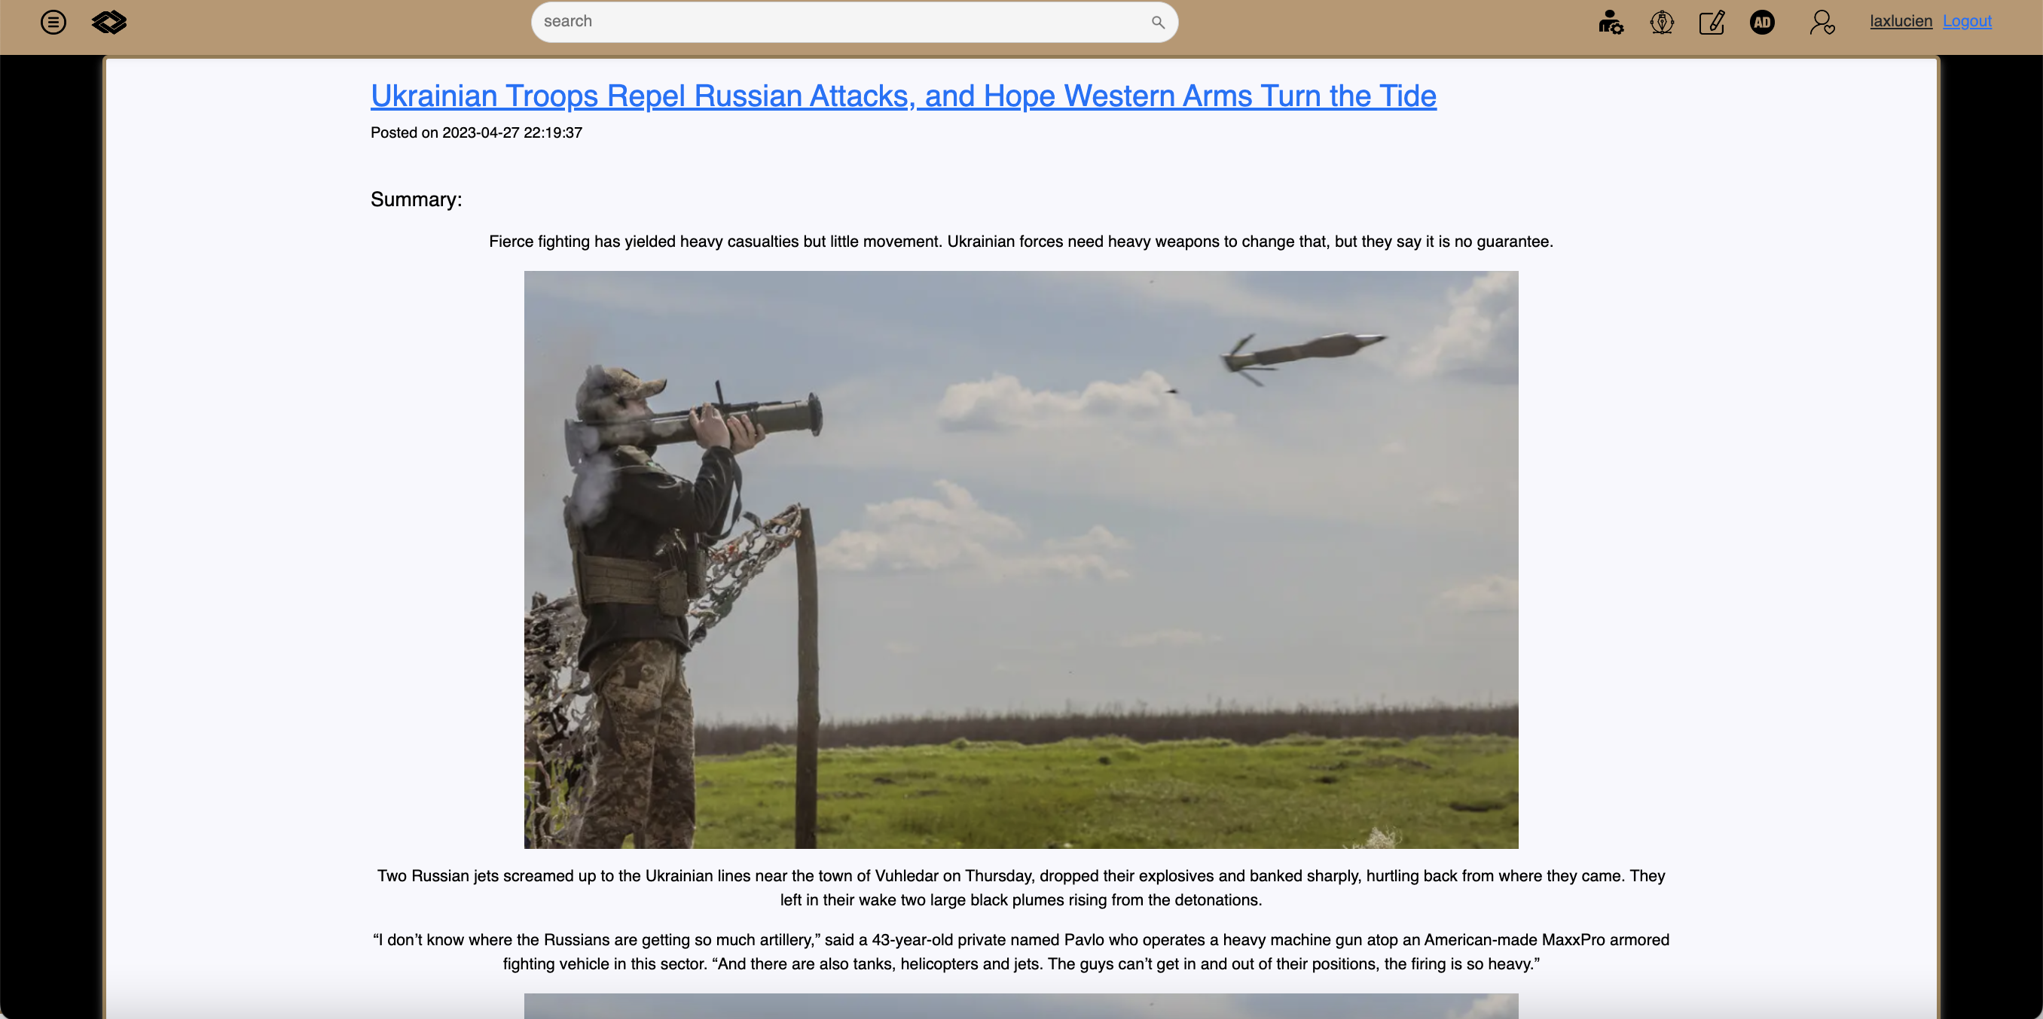
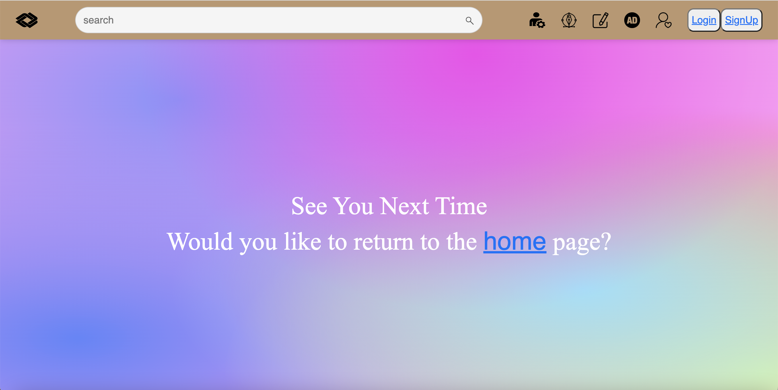
layout
Modified 28 pages
Modified more than 3000 lines of code
V.S: MORE ATTRACITVE
THAN BLOGS

Slide 6
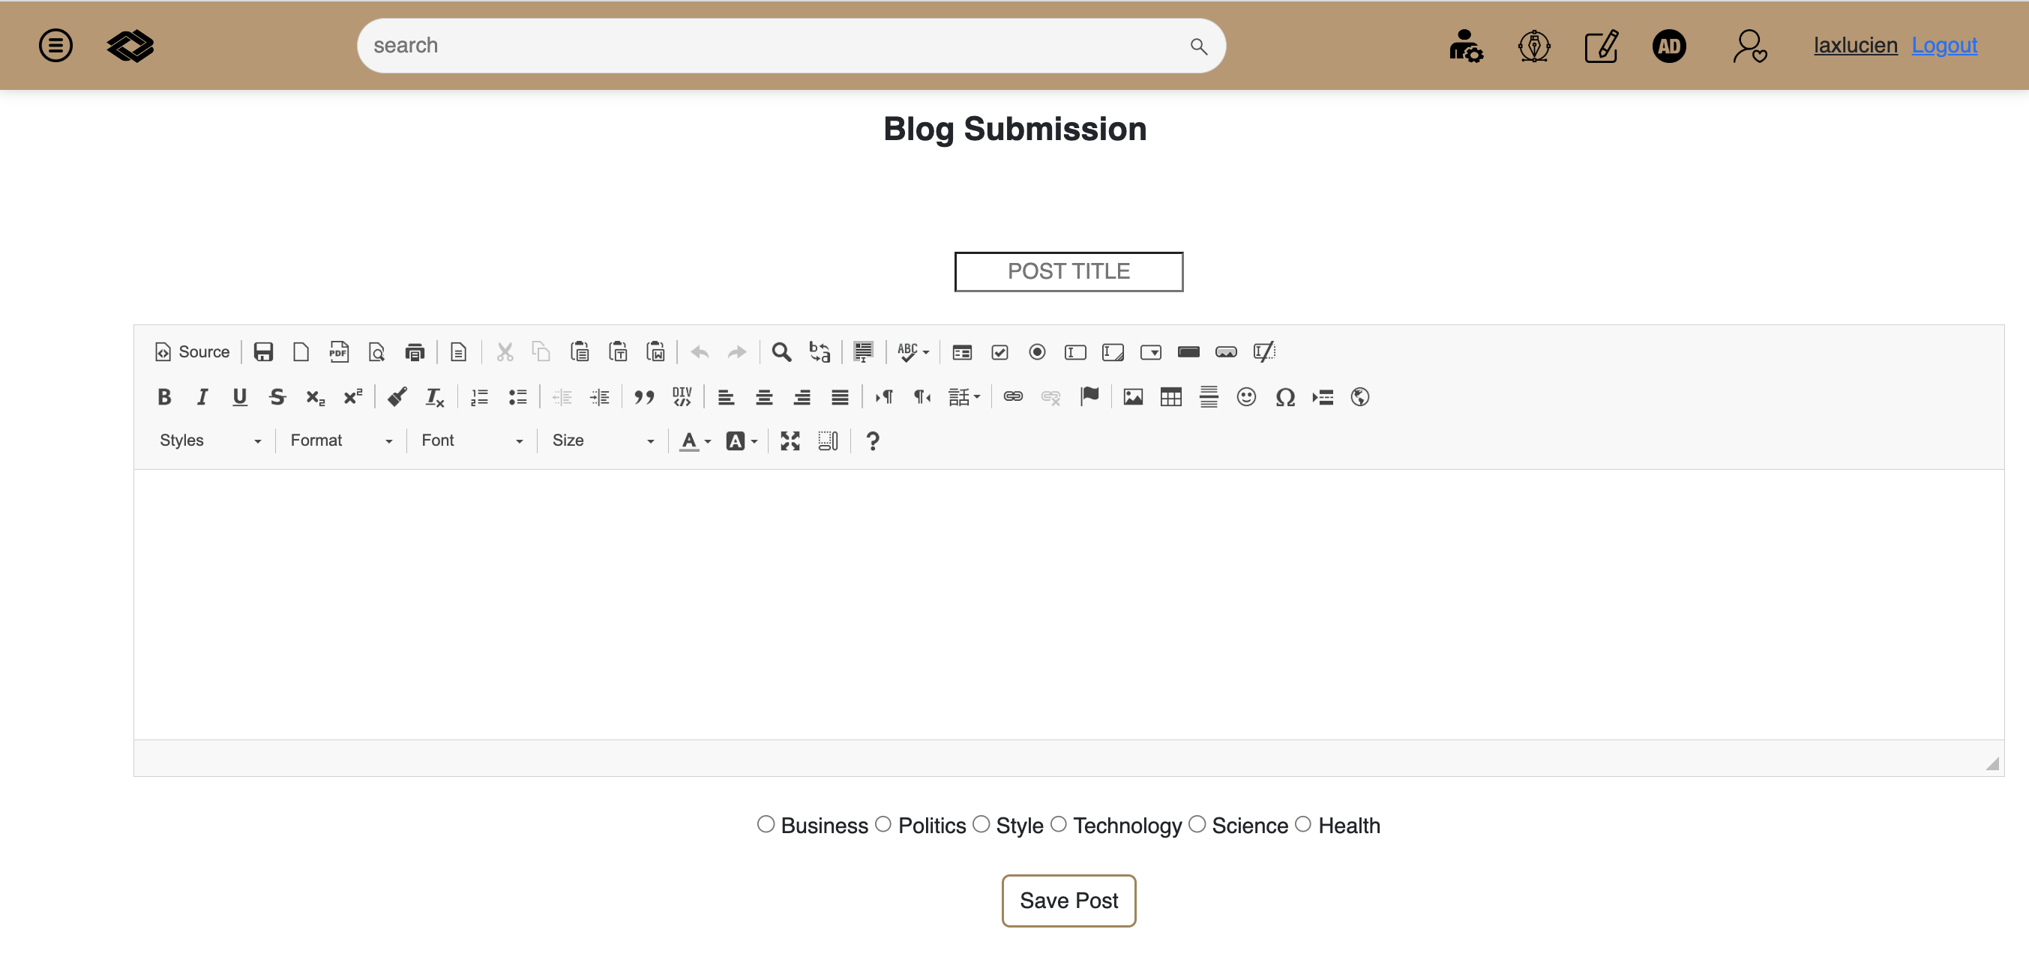
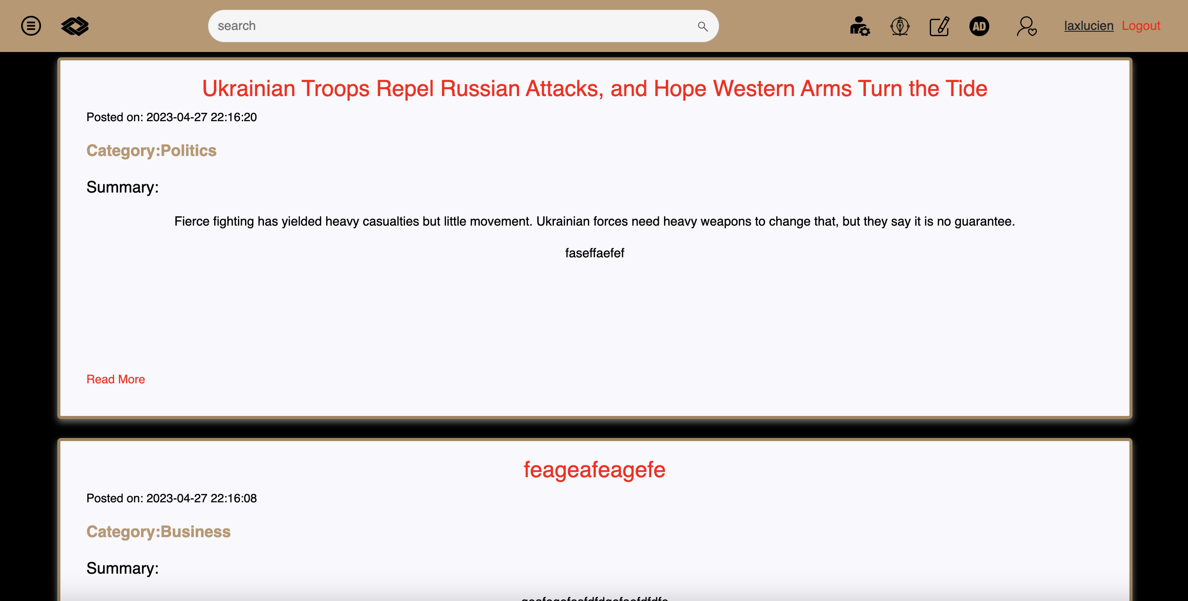
CATEGORY
Add six categories
Add six pages and more than 1200 lines of codes
V.S: EASILIER TO FIND WHAT YOU LIKE

Slide 7
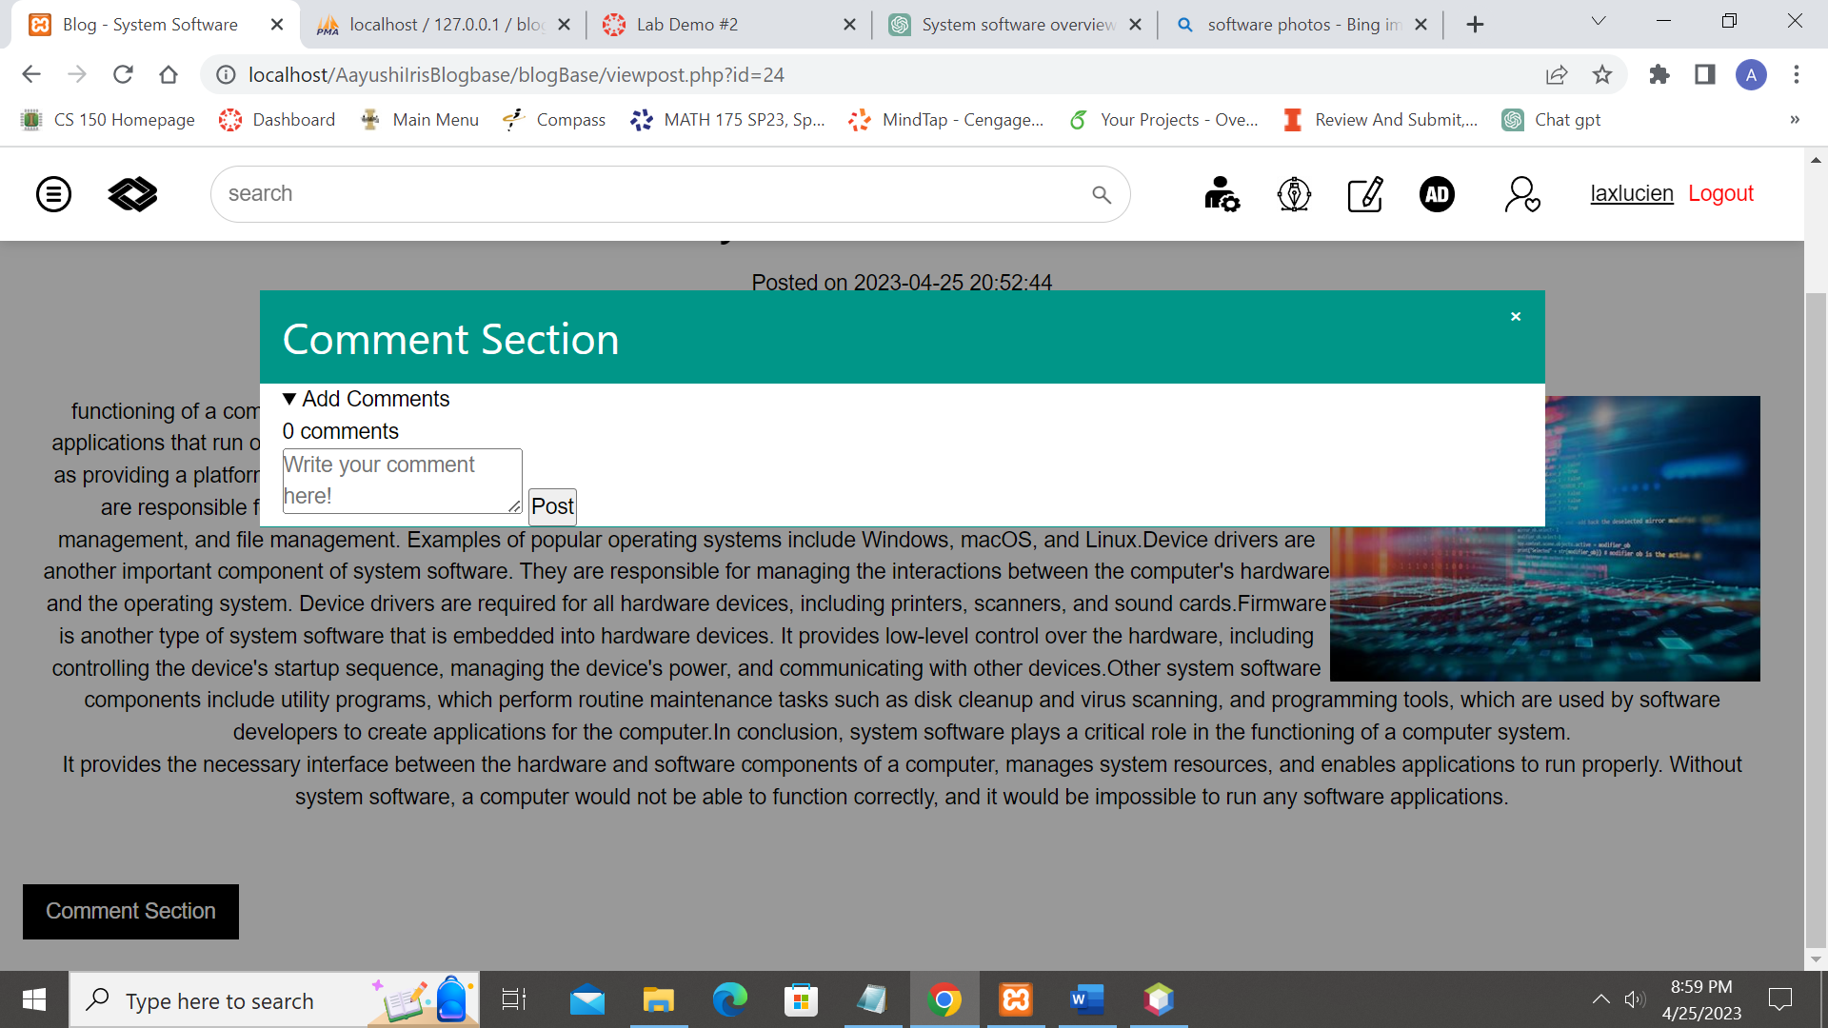
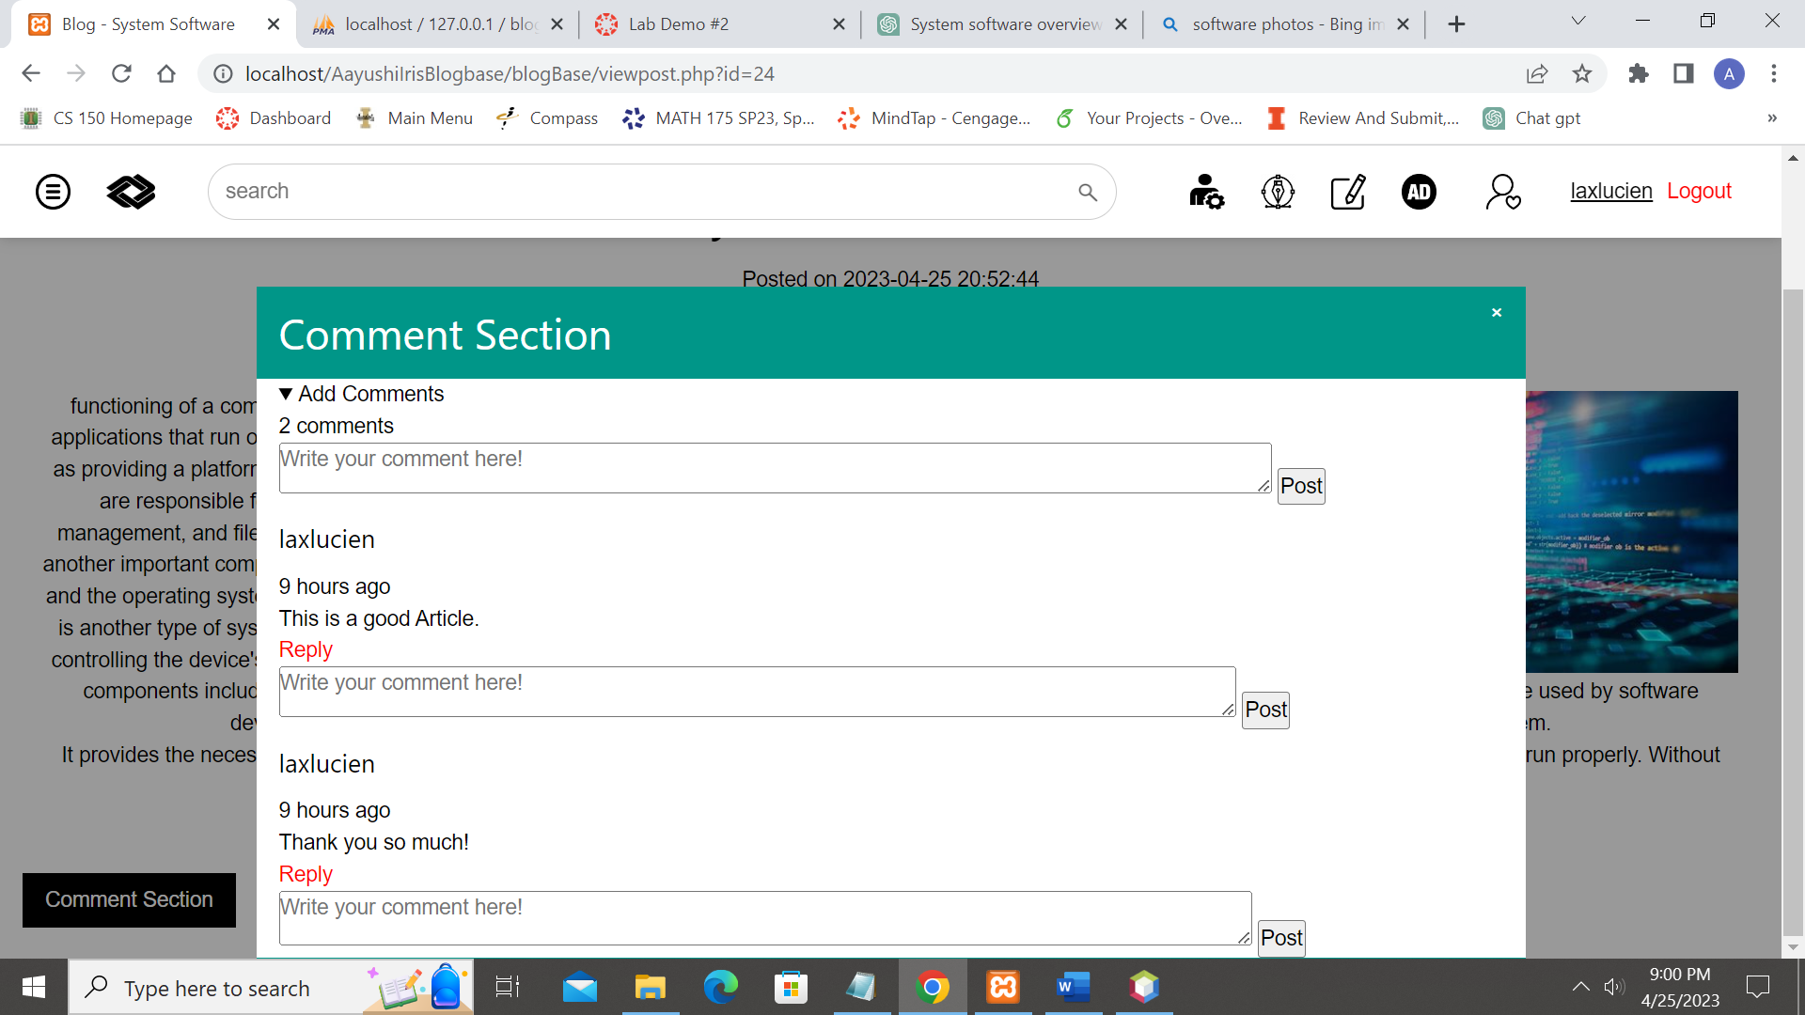
comments
Add lines of codes and modified 120 lines of codes
Improve the style of comments
Can reply the comments

Slide 8
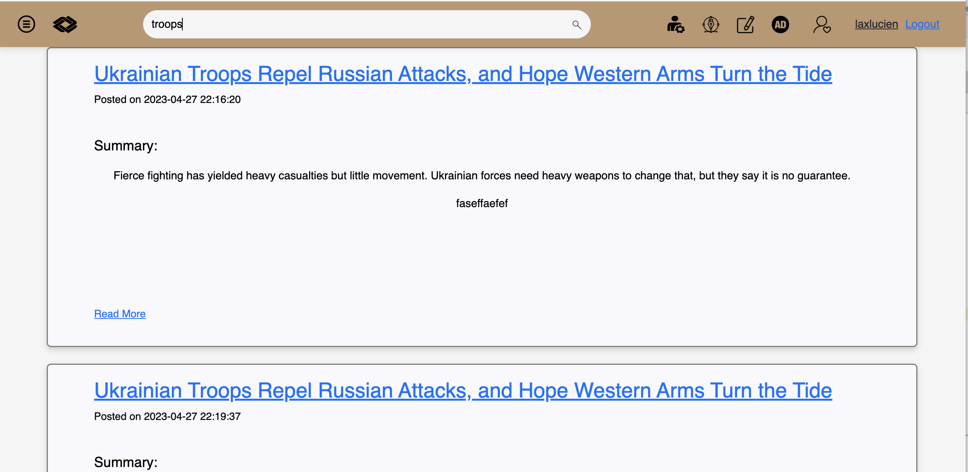
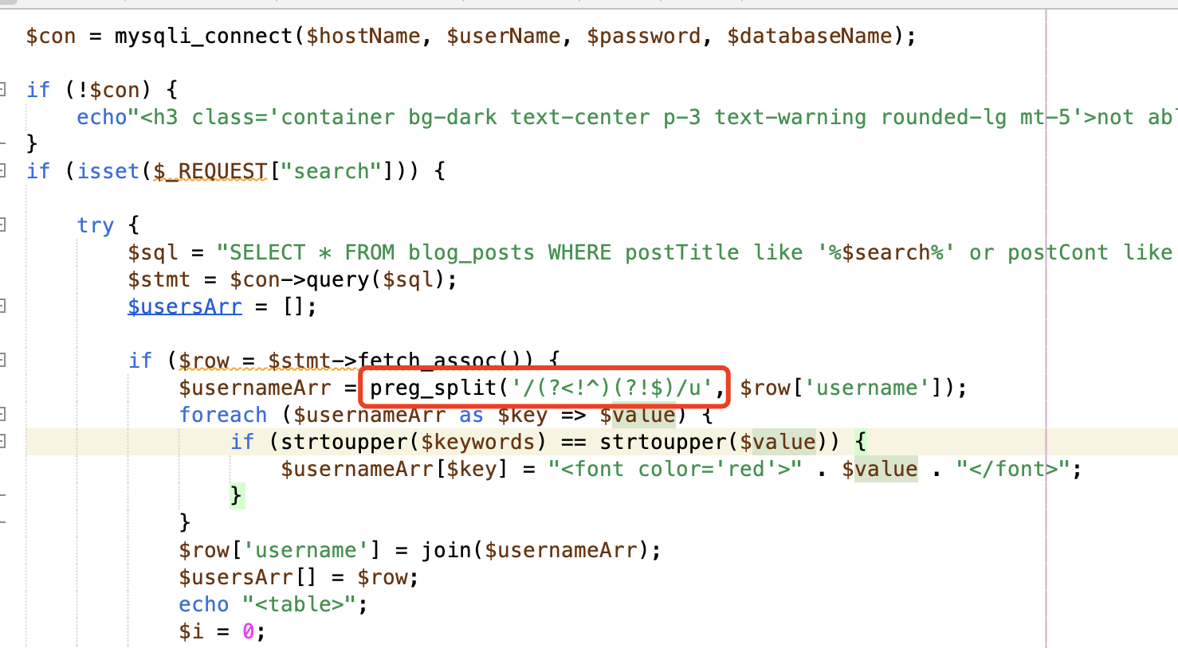
Fuzzy search
Machine Learning : map word into word vector and measure vector distance. Eg. person v.s people
Regularization Expression: Wildcard in SQL and PHP. * - ? . We use SQL regular Expression
V.S: MORE FLEXIBBLE TO FIND WHAT YOU WANT

Slide 9
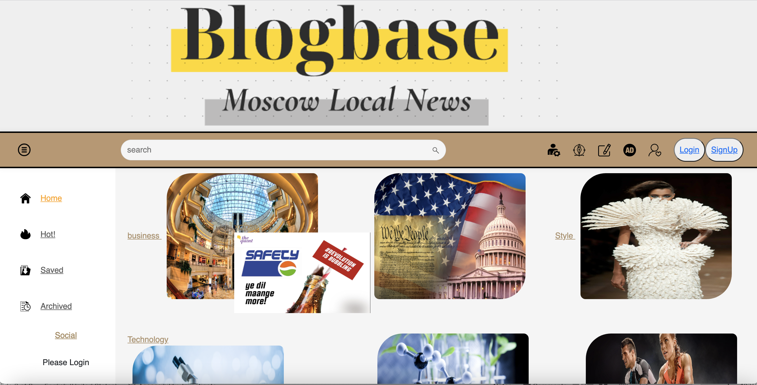
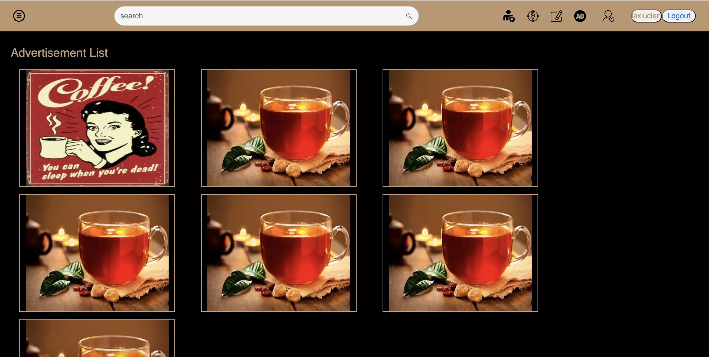
Float windows
Add more than 60 lines of code
Float window navigate to Ad pages
V.S: MORE COMMERCIAL DESIGN WITH FLOAT AD WINDOW

Slide 10
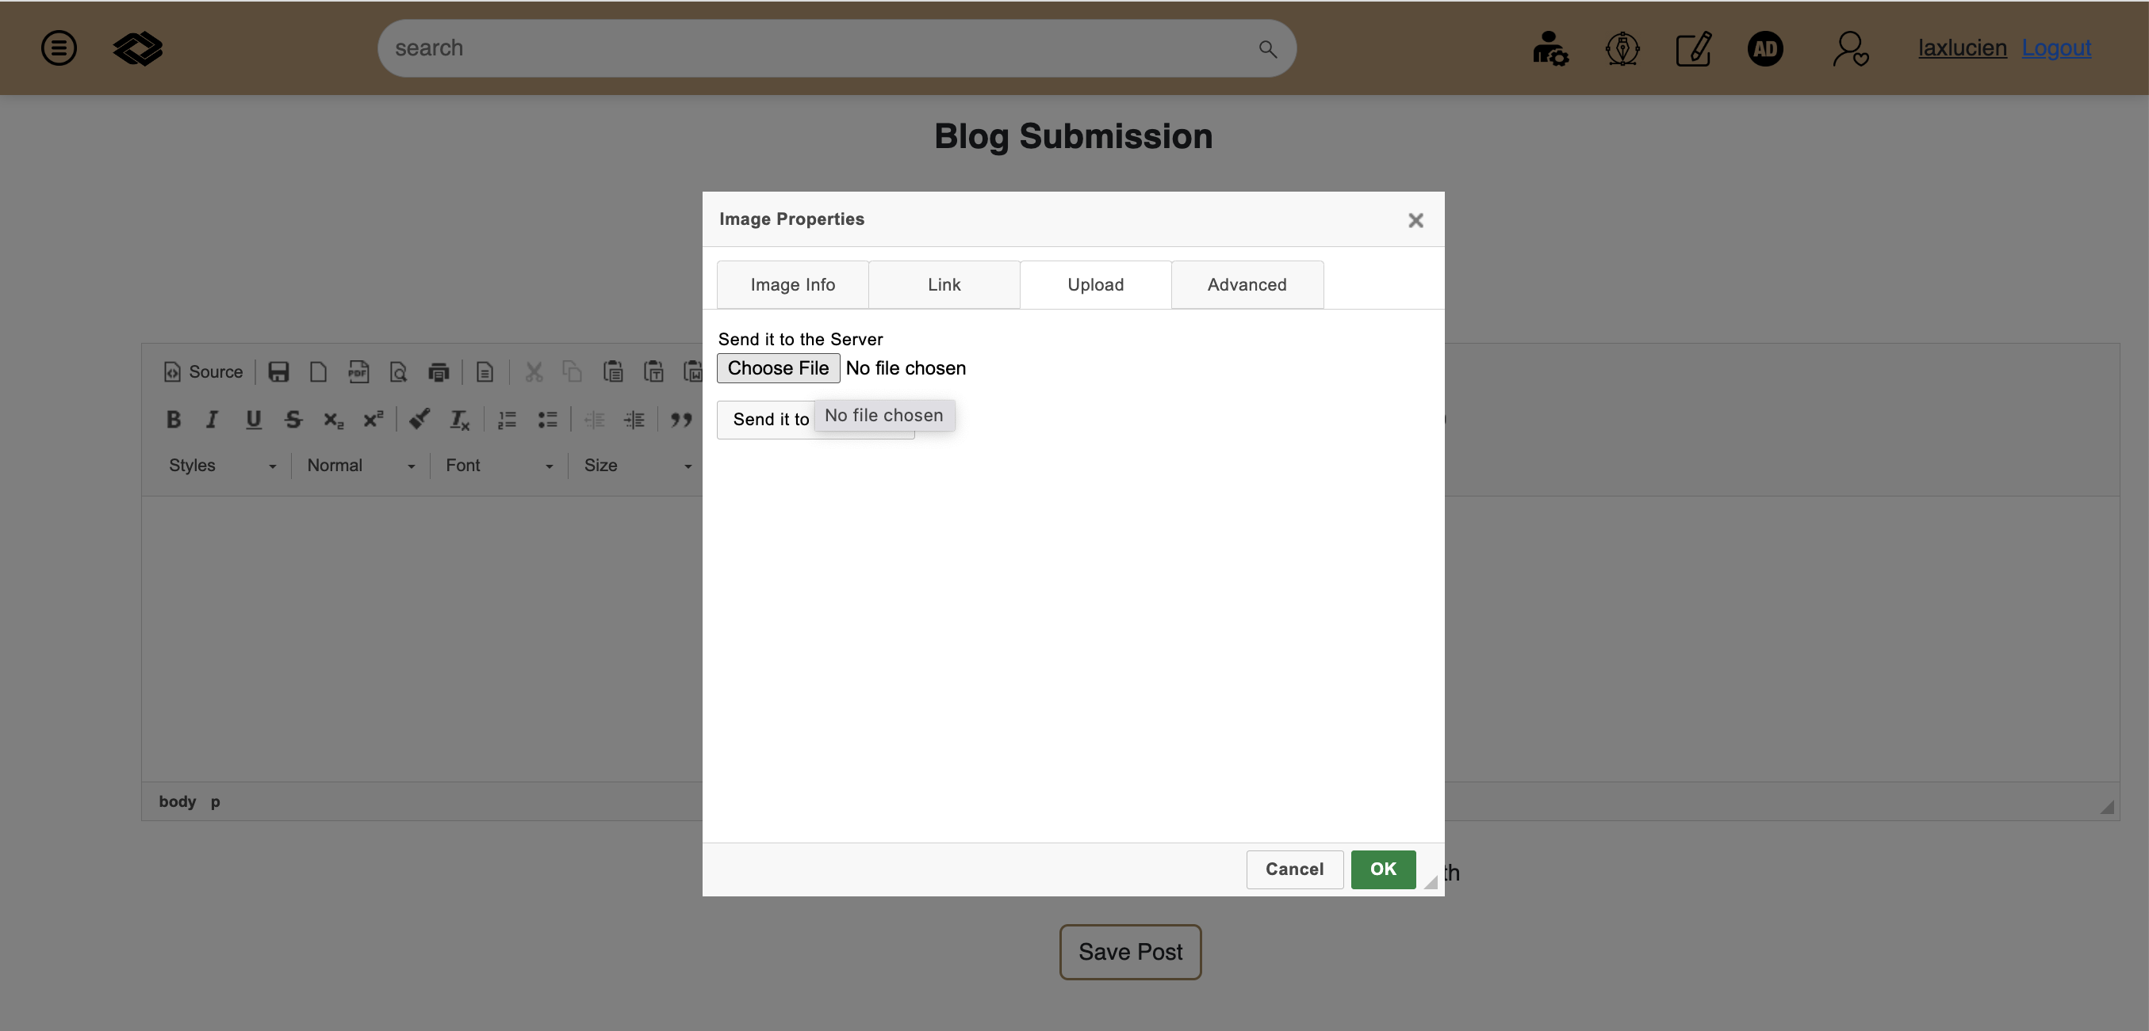
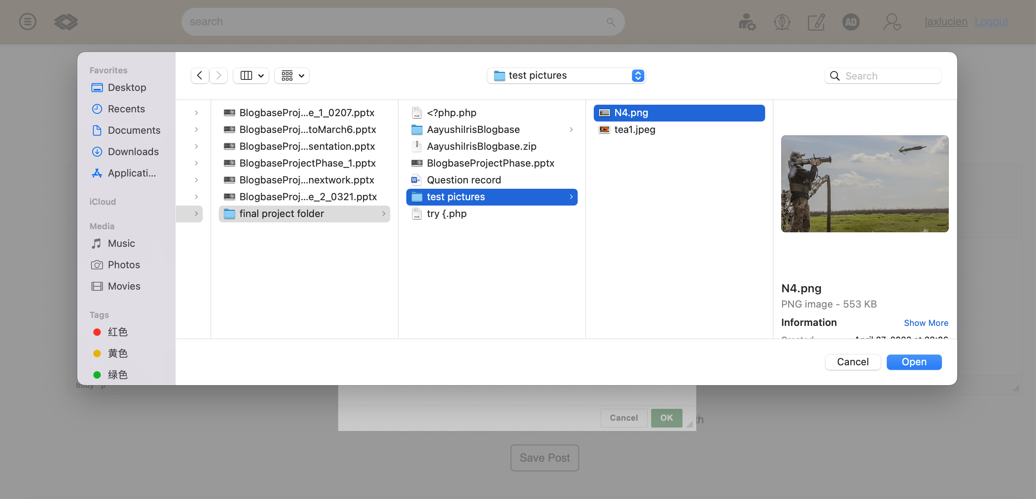
MODIFY CK EDITOR
CK editor can upload pictures from local machine and internet
Modify database
V.S: UPLOAD LONG PASSAGE AND MAKE IT VIVID

Slide 11
OTHER IMPROVES
1. delete 7 redundant files. These files was in the project folder, but was not used in the projects
2. delete more than 500 lines of redundant codes and blanks codes
3. Add comments to the main codes
4. Unified the code format and made consistent indentation.
5. Fix the upload function.
6. Modified database and make the system compatible to MAC.

Slide 12




skills
Php
Html
Css
Sql
javaScript

Slide 13
We struggled but made it through and made a project with full dedication! Thank you for the experience!!

Slide 14
Thank you

